Slide 1
FYP MEETING
ISD 02
2 nd meeting

Slide 2
Agenda
->EAR Table description
->Testing Function of Voice Input
->Testing Function of Voice Output
->New Adaptive Functions of Webpage(Slider)

Slide 3
Entities we used
Account,Activity,Profile,friend,friend_activity,poster,Recent News Entities are existed in the tables.

Slide 4
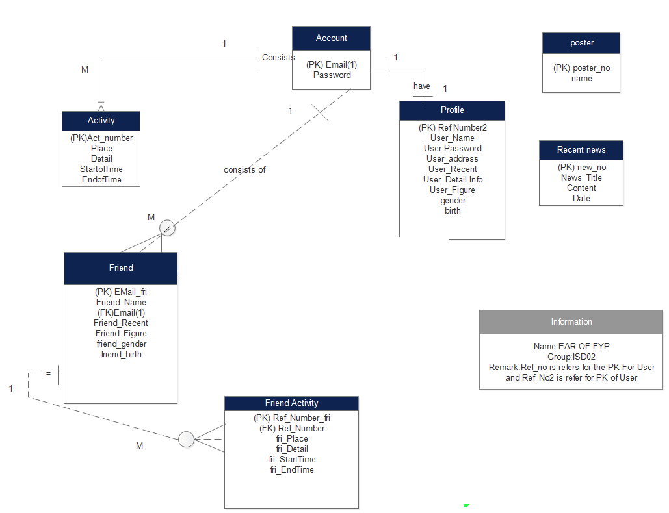
EAR Table

Slide 5
Activity Enities
Data Variable | Data Type | Remark
Act_Number | INT | Primary Key
Place | VARCHAR(80)
Detail | TEXT
StartofTime | TIME
EndofTime | TIME

Slide 6
Account Entities
Data Variable | Data Type | Remark
Email | VARCHAR(30) | Primary Key
Password | VARCHAR(15)

Slide 7
Profile Entities
Data Variable | Data Type | Remark
Ref_Number | INT | Primary Key
User_Name | VARCHAR(30)
User_Password | VARCHAR(40)
User_Address | VARCHAR(50)
User_DetailInfo | TEXT
User_Figure | BLOB
GENDER | CHAR
Birth | Date

Slide 8
Friend Entities
Data Variable | Data Type | Remark
fri_Email | INT | Primary Key
fri_Name | VARCHAR(30)
EMail//(User EMail) | VARCHAR(50) | Foreign key as account entities
Friend_Recent | TEXT
Friend_Figure | BLOB
Friend_gender | CHAR(1)
Friend_birth | DATE

Slide 9
Friend Activity Entities
Data Variable | Data Type | Remark
Ref_Number_fri | INT | Primary Key
Ref_Number(It refer for the number for login user) | INT | Foregin Key
Fri_detail | TEXT
Fri_StartTime | TIME
Fri_EndTime | TIME
User_Figure | BLOB(VARIABLE SPEIFIC FOR STORING THE PICTURE)

Slide 10
Poster Enities
Data Variable | Data Type | Remark
poster_Number | INT | Primary Key
Name | VARCHAR(30)

Slide 11
Recent News Entities
Data Variable | Data Type | Remark
new_Number | INT | Primary Key
New Title | VARCHAR(30)
content | TEXT
Date | DATE

Slide 12
Web Page Layout Update
-> make page more beauty
(Add Slider inside for website)
However,it ‘s difficult to set the size of sliders and photo portablely upon nowsadays.
Therefore,a pure color background added

Slide 13
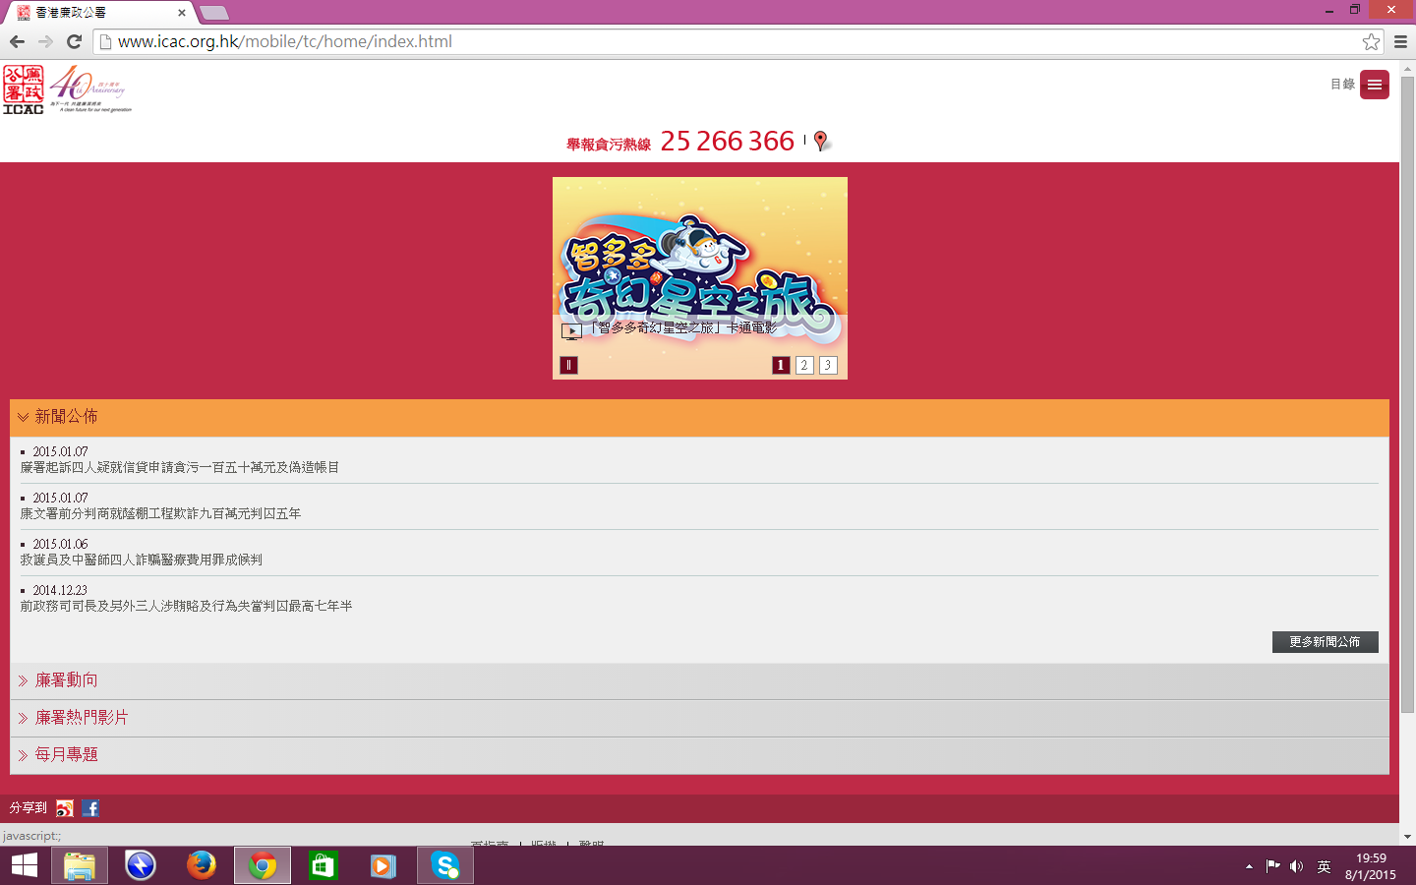
Reference from ICAC Website

Slide 14
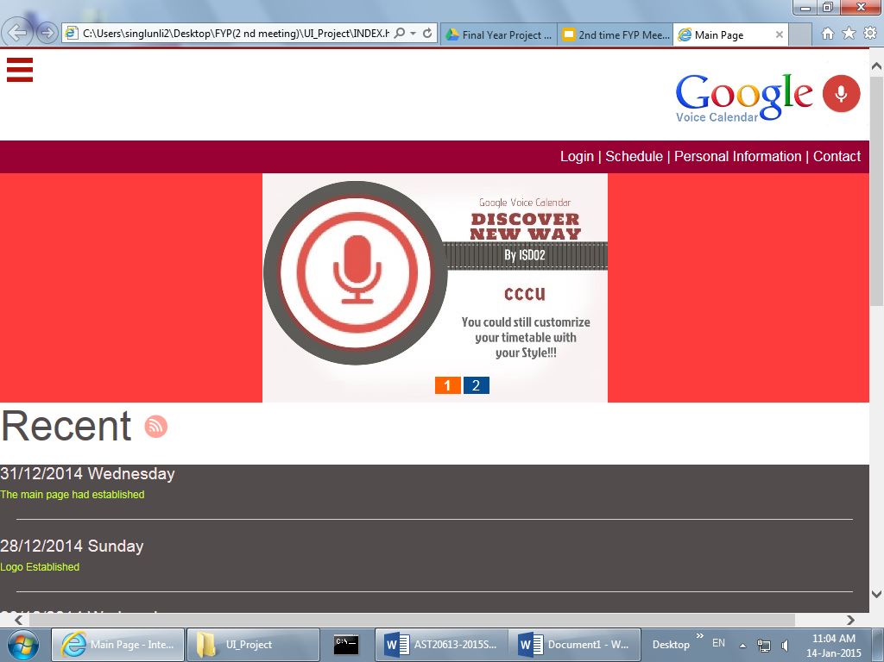

Slide 15
Testing of voice In and output

Slide 16
Plan for Next Time Conference
Design Perspective: ->Focus in Login Page Design:
->Background
->Login Reminder(Use JavaScript)
->UI Design for Login Section

